Slide 1
Deep Dive into LINQ
Eran Sharabi
.NET Development Team Leader
JohnBryce Training
esharabi@johnbryce.co.il

Slide 2
Objectives
Using LINQ in more productivity
Improve LINQ performance

Slide 3
Agenda
Building LINQ from C# 2.0
Deferred vs. Non-Deferred Execution
Enumerable vs. Queryable
Types of LINQ and Tools
Q & A
Summary
Notes:
Tips and Best Practices

Slide 4
Building LINQ from C# 2.0
Generics and Iterators in C# 2.0
Lambda expressions
Extension methods
System.LINQ
LINQ operators

Slide 5
DEMO
Building LINQ from C# 2.0

Slide 6
DEMO
Deferred vs. Non-Deferred Execution

Slide 7

Tips and Best Practices
var bad = from e in GetEmployees()
from p in GetProjects()
where e.GetDepartment() == p.GetDepartment()
select new { Employee = e, Project = p };
var projects = (from p in GetProjects()
select new {
Project = p,
Department = p.GetDepartment() })
.ToArray();
var good = from e in GetEmployees()
let d = e.GetDepartment()
from p in projects
where d == p.Department
select new { Employee = e, Project = p.Project };
join

Slide 8
Tips and Best Practices
System.Collections.ArrayList arrayList;
arrayList.Add(1);
arrayList.Add("string");
// Ew, where's the generics?
List<int> integers = list.OfType<int>().ToList();
List<string> strings = list.OfType<string>().ToList();

Slide 9
Tips and Best Practices
System.Collections.ArrayList arrayList;
arrayList.Add(1);
arrayList.Add(2);
// But they’re all integers!
List<int> list = list.Cast<int>().ToList();

Slide 10
Tips and Best Practices
Aggregate
  Sum, Min, Max, Average, …
Set Operators
  Union, Intersect, Except, SelectMany, SequenceEqual…
More
  http://msdn.microsoft.com/en-us/vcsharp/aa336746.aspx
Extension Methods

Slide 11
DEMO
Tips and Best Practices

Slide 12
Expression Tree
In-memory tree representation of LINQ Query
Any LINQ Query node has it’s own type
XXXExpression classes
ExpressionType Enum
Interpreted to specific data source by specific IQueryProvider like SQLQueryProvider

Slide 13
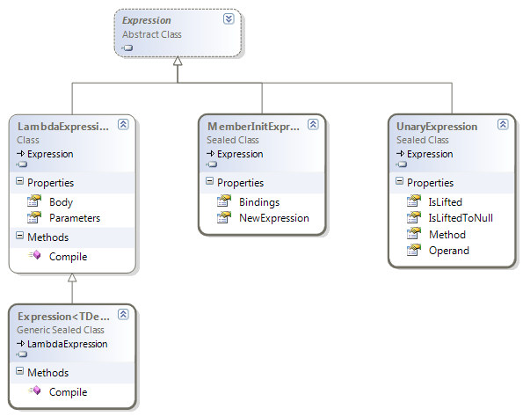
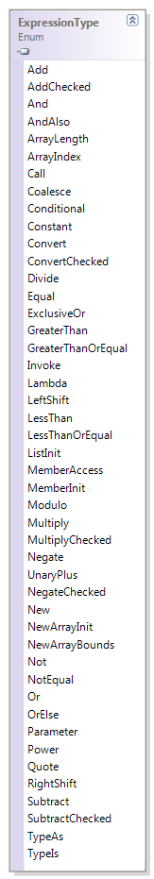
Expression Tree

Slide 14
DEMO
Expression Tree

Slide 15
Enumerable vs. Queryable
Both are static classes
Both contains extension methods
Enumerable extends IEnumarable<T>
Queryable extends IQueryable <T>

Slide 16
Enumerable vs. Queryable
Enumarable
  Func<> delegate as method parameter
  Intended for in-memory sequences iteration
  Invokes the delegate as-is
  public static IEnumerable<TResult> Select<TSource, TResult>(
  this IEnumerable<TSource> source,
  Func<TSource, TResult> selector);

Slide 17
Enumerable vs. Queryable
Queryable
  Expression tree as method parameter
  Expression tree Interpreted to specific data source by IQueryProvider
  There is no “real” delegate
  public static IQueryable<TResult> Select<TSource, TResult>(
  this IQueryable<TSource> source,
  Expression<Func<TSource, TResult>> selector);

Slide 18
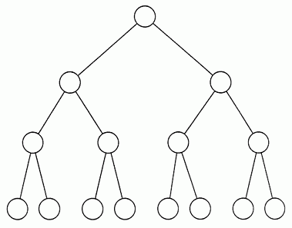
Enumerable vs. Queryable
Queryable
C# 3.0 Query
C# 3.0 Compiler
T-SQL Statements
IQueryProvider

Slide 19
DEMO
Enumerable vs. Queryable

Slide 20
Compiled Query
Specific data source cached query (Like T-SQL)
Saved in the application memory for reuse
Use CompiledQuery.Compile(…)

Slide 21
DEMO
Compiled Query

Slide 22
LINQ Tools
Expression Tree Debugger Visualizer
SqlServer Query Debugger Visualizer
Paste XML as LINQ Add-In
Dynamic LINQ library
LINQPad
VLINQ – Visual LINQ Query Builder
Linqer – SQL to LINQ Converter

Slide 23
DEMO
LINQ Tools

Slide 24
NIH Is Bad!
LINQ to XSD
LINQ to Active Directory
LINQ to WMI
LINQ to Google / Ebay / Amazon…
More:
  http://blogs.microsoft.co.il/blogs/vardi/archive/2008/10/09/the-linq-list-projects.aspx

Slide 25
Tips and Best Practices
Open the connection once for multiple DB queries
dbContext.Connection.Open();
//queries
…
dbContext.Connection.Close();

Slide 26
DEMO
Types of LINQ

Slide 27
Q & A

Slide 28
Summary
Using LINQ in more productivity
Improve LINQ performance

Slide 29
Additional Resources
  Types of LINQ
  http://blogs.microsoft.co.il/blogs/vardi/archive/2008/10/09/the-linq-list-projects.aspx
  101 LINQ samples
  http://msdn.microsoft.com/en-us/vcsharp/aa336746.aspx

Slide 30

Related Sessions
Hardcore C#: Hidden Power and Flexibility
פבל יוסיפוביץ'
09:00-10:30 Galil Hall
Dynamic Languages and the .Net Framework
שי פרידמן
14:30-15:40 Tavor Hall

Slide 31
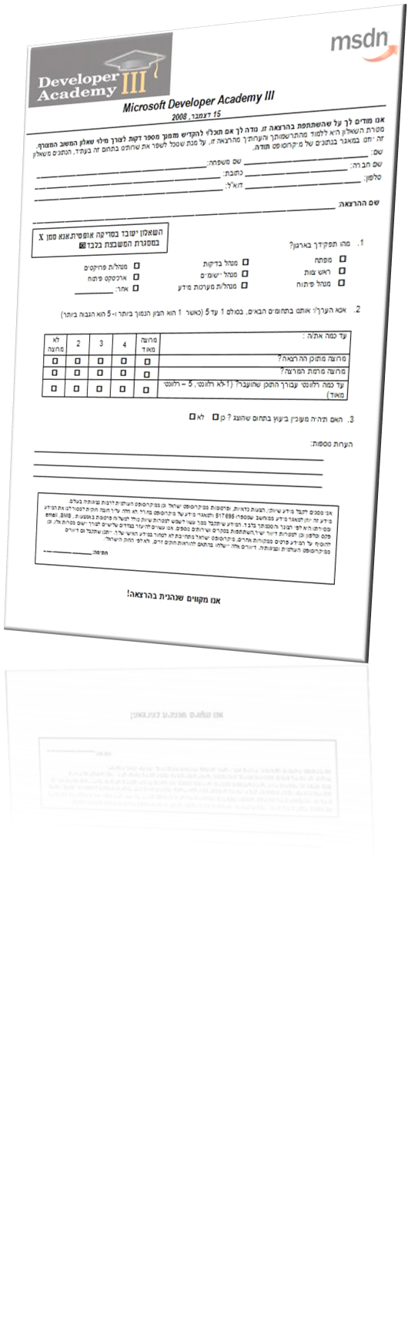


Slide 32

© 2008 Microsoft Corporation. All rights reserved. Microsoft, Windows, Windows Vista and other product names are or may be registered trademarks and/or trademarks in the U.S. and/or other countries.
The information herein is for informational purposes only and represents the current view of Microsoft Corporation as of the date of this presentation. Because Microsoft must respond to changing market conditions, it should not be interpreted to be a commitment on the part of Microsoft, and Microsoft cannot guarantee the accuracy of any information provided after the date of this presentation.
MICROSOFT MAKES NO WARRANTIES, EXPRESS, IMPLIED OR STATUTORY, AS TO THE INFORMATION IN THIS PRESENTATION.
Notes:
© 2007 Microsoft Corporation. All rights reserved. Microsoft, Windows, Windows Vista and other product names are or may be registered trademarks and/or trademarks in the U.S. and/or other countries.
The information herein is for informational purposes only and represents the current view of Microsoft Corporation as of the date of this presentation. Because Microsoft must respond to changing market conditions, it should not be interpreted to be a commitment on the part of Microsoft, and Microsoft cannot guarantee the accuracy of any information provided after the date of this presentation.
MICROSOFT MAKES NO WARRANTIES, EXPRESS, IMPLIED OR STATUTORY, AS TO THE INFORMATION IN THIS PRESENTATION.

